Slide 1

List
Lecturer
Rokas Slaboševičius
Data

Slide 2
Today you will learn
List
Lists - lists
01

Slide 3
What is List?
Lecture title
Lists (List<T>) in C# are very useful and flexible ways to store data. They belong to the .NET System.Collections.Generic library. The main properties of a list are:
Dynamic: Unlike arrays, which have a fixed size, lists in C# are dynamic. This means that you can add or remove items as needed, and the size of the list will automatically adjust.
Generic: Lists are generic, which means they can store any type of element. You simply specify a type parameter when you create a list, e.g. List<int>, List<string>, List<MyClass> etc.
Methods and features: Lists have many useful methods and features. For example, you can use Add to add items, Remove to remove items, Sort to sort, Count to set the number of items etc.
List is a reference type

Slide 4
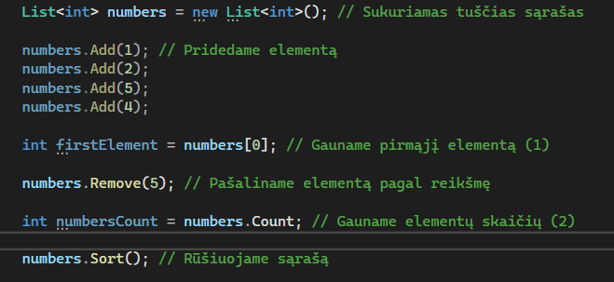
What is List?
Lecture title
Here we can see how the list is created, how items can be added to it, how they can be accessed, deleted or sorted.

Slide 5

What is List?
Lecture title
"Under the hood, we still have the same array, but with more flexibility in its use.
If there is a need, the list can be turned into an array:

Slide 6

List
Task 1
Write a method that accepts a List<string> list and prints the length of each element.
Create a List<int> list with 50 elements (create another method to fill it). Write a method that returns the average of the elements of the list.
Write a method that accepts a List<int> list and returns a list with elements greater than 10.

Slide 7
List
Task 1
Write a method that accepts a List<string> list and returns a new list containing only those words whose sum of letters is an even number. Calculate the sum of the letters from the ASCII code.(How to get the ASCII code - google)
Write a method that accepts a List<int> list and returns the factorial of each number in the new list.
Create a method that accepts a List<string> list. The method should return a list containing only those words whose sum of letters is a prime number. Calculate the sum of the letters from the ASCII code.

